Slide 1

Notes:
Chapter 1: An Introduction to Information Systems
This chapter presents basic concepts necessary to understand systems and business information systems.

Slide 2

Ease the managing task
Guide for problem solving & decision making
Advance in carrier. Realise opportunities and meet personal and company goals.
In Business: used in all functional areas.
CBIS important for type of job.

Slide 3

Data vs. Information
  Data
    Raw facts
    Distinct pieces of information, usually formatted in a special way
  Information
    A collection of facts organized in such a way that they have additional value beyond the value of the facts themselves

Slide 4

Data – thermometer readings of temperature taken every hour:
16.0, 17.0, 16.0, 18.5, 17.0,15.5….
Information – today’s high: 18.5
today’s low: 15.5
Transformation

Slide 5

Data | Represented by
Alphanumeric data | Numbers, letters, and other characters
Image data | Graphic images or pictures
Audio data | Sound, noise, tones
Video data | Moving images or pictures

Slide 6

Data
Transformation
Information

Slide 7

  accurate,
  complete,
  economical,
  flexible,
  reliable,
  relevant,
  simple,
  timely,
  verifiable,
  accessible,
  secure

Slide 8
You want the information about you in a health information system to be:
  As accurate as possible (e.g. your age, sex)
  As complete as possible
  Relevant
  To be reliable
  Should be available in a timely manner (e.g. information about your drug allergies are available before your operation!)

Slide 9
Definition
  A set of elements or components that interact to accomplish goals
  A combination of components working together

Slide 10
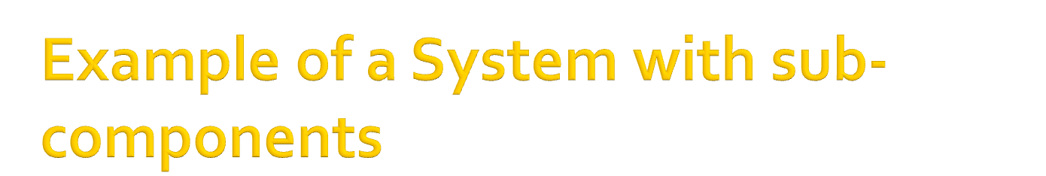
Customer
Maintenance
Component
Order Entry
Component
Customer Support System
Catalog
Maintenance
Component
Order Fulfillment
Component

Slide 11

(1) Refers to a combination of components working together. For example, a computer system includes both hardware and software. A Windows system is a personal computer running the Windows operating system. A desktop publishing system is a computer running desktop publishing software.
(2) Short for computer system.
(3) Short for operating system.
(4) An organization or methodology. The binary numbering system, for instance, is a way to count using only two digits

Slide 12

Inputs
Processing mechanisms
Outputs

Slide 13

System | Elements |  |  | Goal
 | Inputs | Processing elements | Outputs
Movie | Actors, director, staff, sets, equipment | Filming, editing, special effects, distribution | Finished film delivered to movie studio | Entertaining movie, film awards, profits

Slide 14

System boundary
  Defines the system and distinguishes it from everything else
System types
  Simple vs. complex
  Open vs. closed
  Stable vs. dynamic
  Adaptive vs. non-adaptive
  Permanent vs. temporary

Slide 15
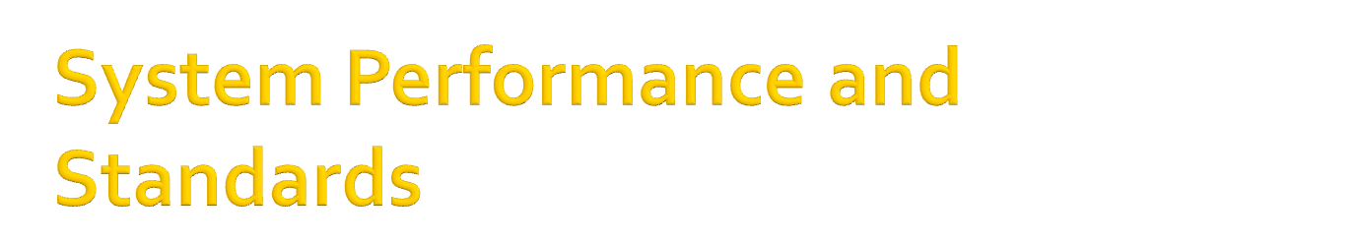
Efficiency
  A measure of what is produced divided by what is consumed (eg. Efficiency of a motor is the energy produced divided by what is consumed)
Effectiveness
  A measure of the extent to which a system achieves its goals
System performance standard
  A specific objective of the system

Slide 16
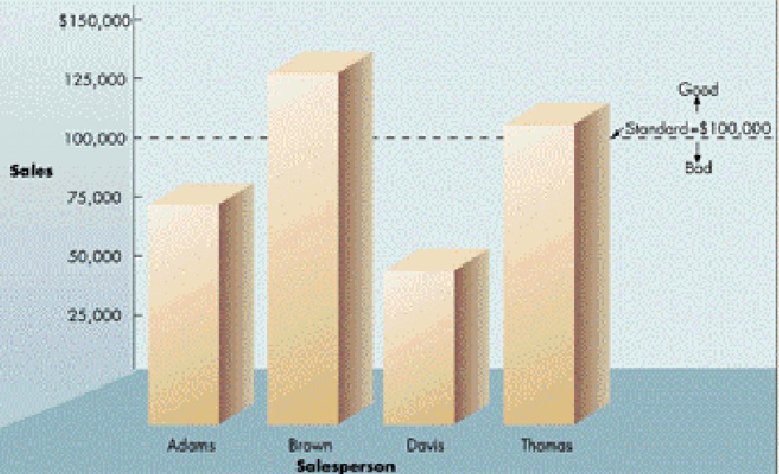
Figure 1

Slide 17
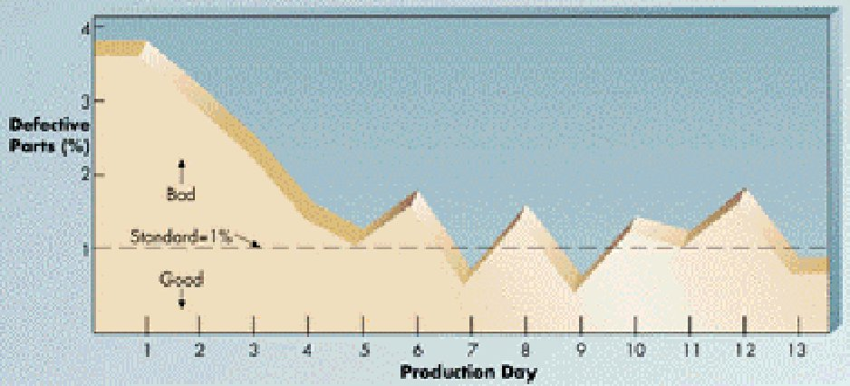
Figure 1.5b

Slide 18

System variable
  A quantity or item that can be controlled by the decision maker
  E.g. the price a company charges for a product
System parameter
  A value or quantity that cannot be controlled by the decision maker
  E.g., cost of a raw material

Slide 19

Model
  An abstraction or an approximation that is used to represent reality
Types of models
  Narrative (aka descriptive)
  Physical
  Schematic
  Mathematical
Next slide

Slide 20
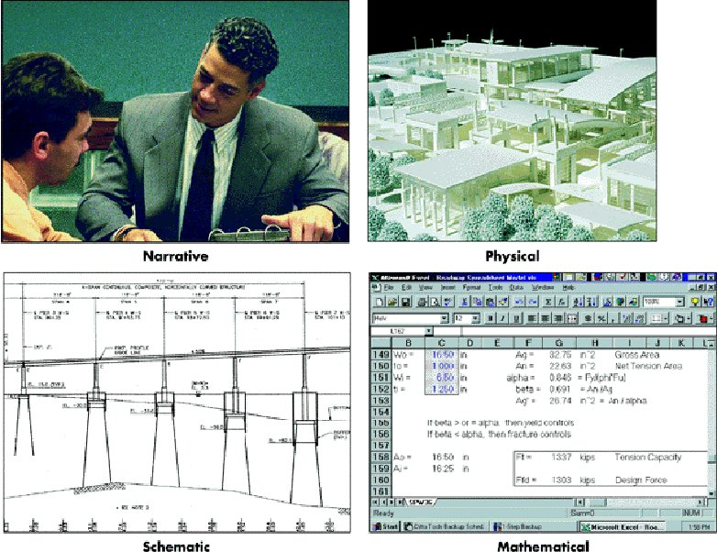

Slide 21

Make understanding complex systems easier (simplifies)
Can be used to design – make models of new systems so can refine them
Makes communication about systems easier (e.g. a picture can communicate a thousand words)

Slide 22

Definition
  A set of interrelated elements or components that collect (input), manipulate (process), and disseminate (output) data and information and provide a feedback mechanism to meet an objective
  (IS) Pronounced as separate letters, and short for Information Systems or Information Services. For many companies, IS is the name of the department responsible for computers, networking and data management. Other companies refer to the department as IT (Information Technology) and MIS (Management Information Services).

Slide 23

Environment
Organisation
Input
Processing
Output
Feedback

Slide 24

External Environment
People
Organisation
Information
System
Technology

Slide 25

Input
  The activity of gathering and capturing data
  Whatever goes into the computer
Processing
  Converting or transforming data into useful outputs
Output
  Useful information, usually in the form of documents and/or reports
  Anything that comes out of a computer

Slide 26

(n) Whatever goes into the computer. Input can take a variety of forms, from commands you enter on a keyboard to data from another computer or device. A device that feeds data into a computer, such as a keyboard or mouse, is called an input device.
(v) The act of entering data into a computer

Slide 27

(n) Anything that comes out of a computer. Output can be meaningful information or gibberish, and it can appear in a variety of forms -- as binary numbers, as characters, as pictures, and as printed pages. Output devices include display screens, loudspeakers, and printers.
(v) To give out. For example, display screens output images, printers output print, and loudspeakers output sounds.

Slide 28

Feedback
  Output that is used to make changes to input or processing activities
Forecasting
  A proactive approach to feedback
  Use for estimating future sales or inventory needs

Slide 29
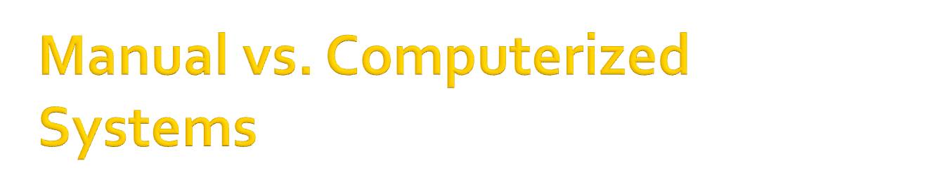
Manual systems still widely used
  E.g., some investment analysts manual draw charts and trend lines to assist them in making investment decisions
Computerized systems
  E.g., the above trends lines can be drawn by computer
Evolution
  Many computerized system began as manual systems
  E.g., directory assistance (“911”)

Slide 30
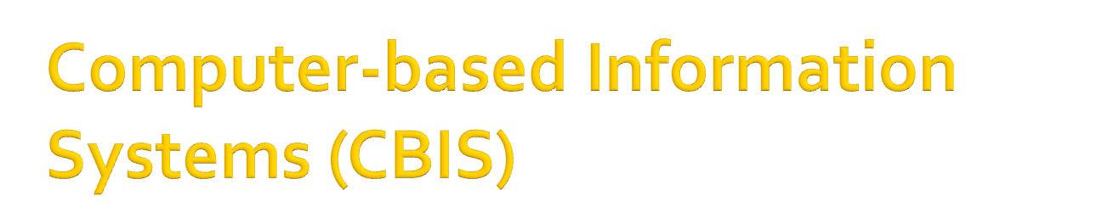
A CBIS is composed of…
  Hardware
  Software
  Databases
  Telecommunications
  People
  Procedures
Together they are…
  Configured to collect, manipulate, store, and process data into information

Slide 31

Five parts
  Hardware
  Software
  Database
  Telecommunications
  Networks

Slide 32

Five parts
  Hardware
  Software
  Database
  Telecommunications
  Networks

Slide 33

Hardware
  Computer equipment used to perform input, processing, and output activities
  The objects that you can actually touch, like disks, disk drives, display screens, keyboards, printers, boards, and chips.

Slide 34

Hardware refers to objects that you can actually touch, like disks, disk drives, display screens, keyboards, printers, boards, and chips. In contrast, software is untouchable. Software exists as ideas, concepts, and symbols, but it has no substance.
Books provide a useful analogy. The pages and the ink are the hardware, while the words, sentences, paragraphs, and the overall meaning are the software. A computer without software is like a book full of blank pages -- you need software to make the computer useful just as you need words to make a book meaningful.

Slide 35

Five parts
  Hardware
  Software
  Database
  Telecommunications
  Networks

Slide 36

Software
  Computer programs that govern/determine/control the operation of the computer
  Computer instructions or data

Slide 37

Software is computer instructions or data. Anything that can be stored electronically is software. The storage devices and display devices are hardware.
The terms software and hardware are used as both nouns and adjectives. For example, you can say: "The problem lies in the software," meaning that there is a problem with the program or data, not with the computer itself. You can also say: "It's a software problem.“

Slide 38

The distinction between software and hardware is sometimes confusing because they are so integrally linked. Clearly, when you purchase a program, you are buying software. But to buy the software, you need to buy the disk (hardware) on which the software is recorded.
Software is often divided into two categories. Systems software includes the operating system and all the utilities that enable the computer to function. Applications software includes programs that do real work for users. For example, word processors, spreadsheets, and database management systems fall under the category of applications software.

Slide 39

Five parts
  Hardware
  Software
  Database
  Telecommunications
  Networks

Slide 40

Database
  An organized collection of facts and information
  A collection of information organized in such a way that a computer program can quickly select desired pieces of data

Slide 41

A database is a collection of information organized in such a way that a computer program can quickly select desired pieces of data.
You can think of a database as an electronic filing system. Traditional databases are organized by fields, records, and files. A field is a single piece of information; a record is one complete set of fields; and a file is a collection of records. For example, a telephone book is analogous to a file. It contains a list of records, each of which consists of three fields: name, address, and telephone number.

Slide 42

An alternative concept in database design is known as Hypertext. In a Hypertext database, any object, whether it be a piece of text, a picture, or a film, can be linked to any other object. Hypertext databases are particularly useful for organizing large amounts of disparate information, but they are not designed for numerical analysis.
To access information from a database, you need a database management system (DBMS). This is a collection of programs that enables you to enter, organize, and select data in a database.

Slide 43

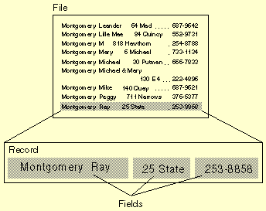

Slide 44

Five parts
  Hardware
  Software
  Database
  Telecommunications
  Networks

Slide 45

Telecommunications
  The electronic transmission of signals for communications; enables organizations to link computer systems into effective networks
  Refers to all types of data transmission, from voice to video

Slide 46

Five parts
  Hardware
  Software
  Database
  Telecommunications
  Networks

Slide 47

Network
  Used to connect computers and computer equipment in a building, around the country, across the world, to enable electronic communications
  A group of two or more computer systems linked together

Slide 48

There are many types of computer networks, including:
local-area networks (LANs) : The computers are
geographically close together (that is, in the same building).
wide-area networks (WANs) : The computers are farther apart and are connected by telephone lines or radio waves.

Slide 49

In addition to these types, the following characteristics are also used to categorize different types of networks:
topology : The geometric arrangement of a computer system. Common topologies include a bus, star, and ring.
protocol : The protocol defines a common set of rules and signals that computers on the network use to communicate. One of the most popular protocols for LANs is called Ethernet. Another popular LAN protocol for PCs is the IBM token-ring network .
architecture : Networks can be broadly classified as using either a peer-to-peer or client/server architecture.

Slide 50

Computers on a network are sometimes called nodes.
Computers and devices that allocate resources for a network are called servers.

Slide 51


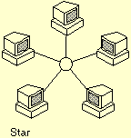
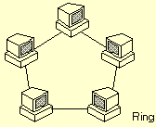

Slide 52

Internet
  The world’s largest telecommunications network
  A network of networks
  Free exchange of information
  A global network connecting millions of computers.
Intranet
  A network that uses Internet technology within an organization
  A network belonging to an organization

Slide 53

People
  The most important element in most computer-based information systems
  Includes people who manage, run, program, and maintain the system
  E.g., IT professionals (you!)
Procedures
  Includes the strategies, policies, methods, and rules for using the CBIS

Slide 54

Resume slide hlm 22-54
Cari hal-hal yang berkaitan tentang bisnis & proses bisnis.
Dikirim paling lambat tanggal 14 sep jam 20.00
ichantaufik@gmail.com
Subjet : Tugas 1 SI NIM-Nama-Kls

